Slide 1
Data Analytics

Slide 2
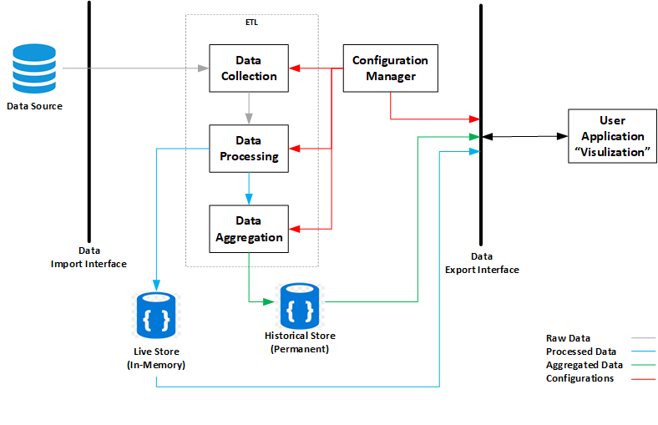
System Overview
Independent.
Configurable.
Extendable.
Scalable.

Slide 3
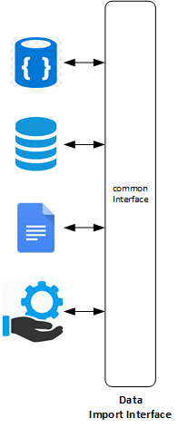
Modules – Import interface
Provide a connection to the data source.
Provide API to query from the data source.
Abstract specific data source technology from the system (hide, network, security and query issues from the system).

Slide 4
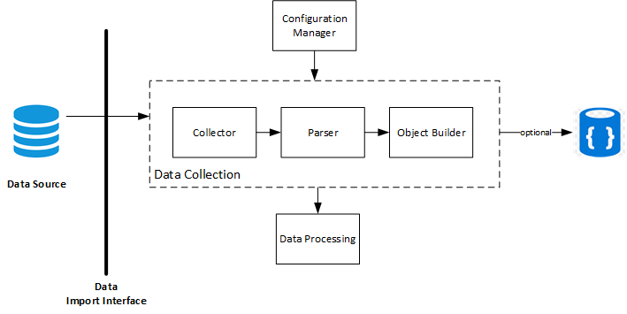
Modules – Data Collection
Periodically pull data from the data source.
Depend on the form of the data we might need to parse it.
Generate a unified object (Key, Value) of the data. Timestamp and Stream id information are added to the data

Slide 5
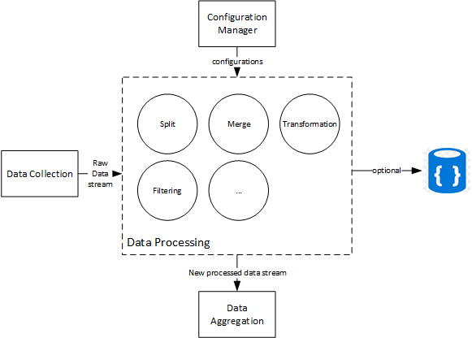
Modules – Data Processing
It receive the data a stream of information coming from Data Collection Module.
Several processing methods can be applied, all should be configurable.
New streams of processed data then move to the next module (aggregation).

Slide 6
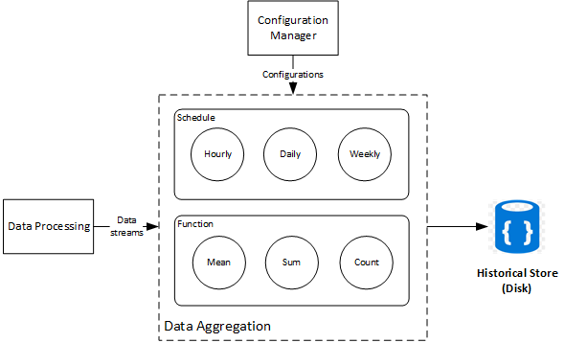
Modules – Data Aggregation
It receive the data streams from the processing module.
Two configuration are required, aggregation schedule, and aggregation function.
Aggregated data are stored into Historical Data Store.
Multiple aggregation schedule can be defined for the same data.

Slide 7
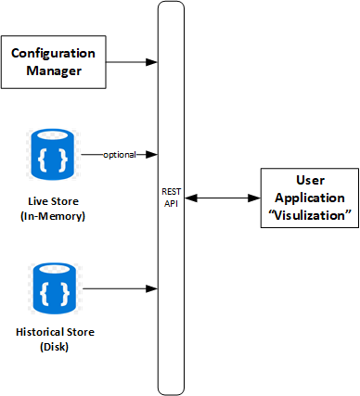
Modules – Data Interface
Offers a standard interface to user application to query the Historical Data (and Live Data if supported).
The user application could also retrieve a meta description of the data (names, types and etc.)

